Slide 1

Decoding What makes a Chartbuster: Predictive Modeling of Song Popularity based on Spotify Audio Features
By Yusuf Saadu

Slide 2
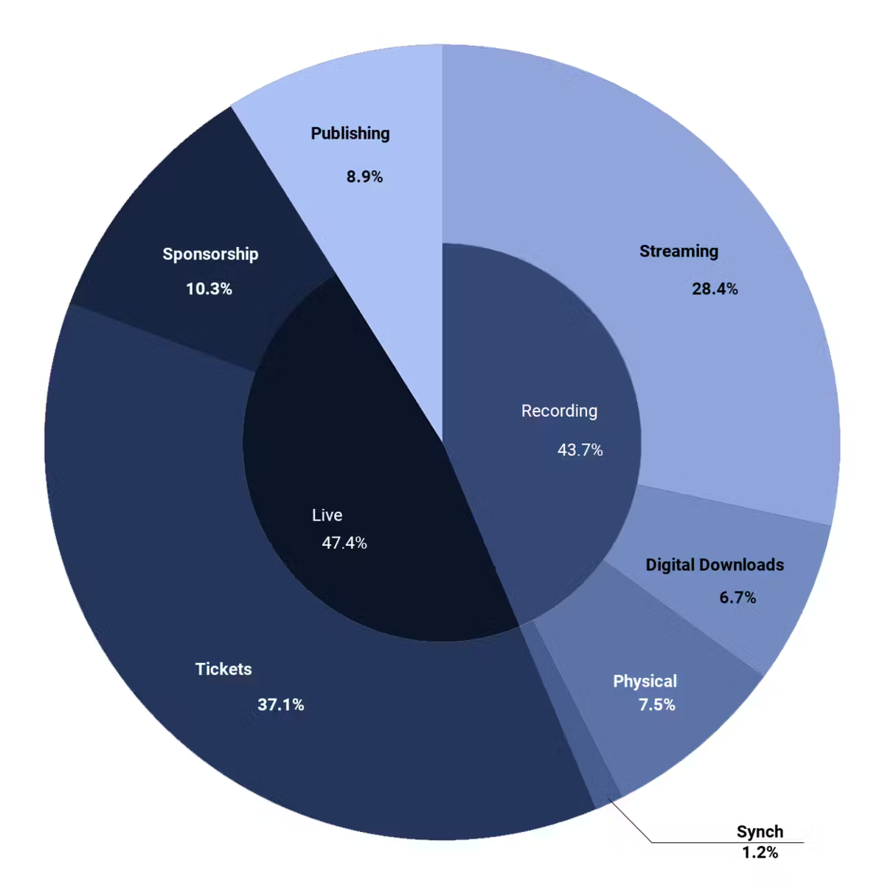
Introduction
The Current Music Industry and the Streaming Takeover
The Value of a Hit
Modern sources of Revenue in the Music Industry
What Makes a Hit?
The Gamble for Music Labels and Artistes
Picking the right Song
What is the model and How does it help?
A real word scenario- The Dominance of Spotify
https://soundcharts.com/blog/us-music-market-overview

Slide 3

How Does the Model Work?
Likening Spotify Music Streaming Charts to the Stock Market
Benefits of Accurate Estimation
Possible losses incurred without a solid model
Project Aim- A regression model that accurately predicts the likely popularity of a song on Spotify based on its quantified audio features.
Used by labels and artistes to direct funding
The effect of factors outside quantifiable audio features

Slide 4
Research Questions
What audio features most significantly predict a song's popularity on platforms like Spotify?
How can predictive models informed by stock market forecasting techniques be adapted for the music industry? Can it have high accuracy?
What is the correlation between Spotify's audio feature data and the commercial success of a song across different revenue streams?
How can music labels and artists use quantitative data to make informed decisions about which songs to promote?
To what extent can historical Spotify data be used to create an accurate popularity scoring system for new music tracks?
What challenges exist in creating a predictive algorithm for song popularity that is robust across various music genres and artist profiles?
How does the predictive model account for the dynamic and evolving trends in music consumption and audience preferences?

Slide 5

Data Source
Sourced through Spotify API scraper
Dataset Size - (1159764 rows, 20 columns)
Data type – Numerical and Categorical
Dependent Variable- Popularity
Independent Variables- Danceability, Loudness, Acousticness, Valence, Tempo, Instrumentalness, Mode, Time Signature, Duration_ms, Speechiness, Liveness

Slide 6
What Variables Are Used in the Model?
Variable | Definition
Popularity | Measures how many plays a track gets as well as how recently people listened to it
Danceability | Measures a track's suitability for dancing
Energy | Assesses a track's intensity and activity
Key | Identifies the track's musical pitch class
Loudness | Averages the track's volume in decibels
Mode | Indicates major or minor modality of a track
Speechiness | Proportion of spoken words in a track
Acousticness | Likelihood of a track being acoustic
Instrumentalness | Probability of a track having no vocals
Liveness | Presence of an audience in the recording
Valence | The track's conveyed mood or positiveness
Tempo | Speed of a track in beats per minute
Duration_Ms | Track length in milliseconds
Time_Signature | Beats per bar in a track's measure

Slide 7


The Most Popular Song in the Dataset
The song "Flowers" by Miley Cyrus, released in 2023, stands out with a perfect popularity score, highlighting its widespread acclaim. It features an upbeat tempo of 118 BPM, aligning with its pop genre classification and ensuring a danceable rhythm that's reinforced by high danceability and energy scores. The track resonates in the key of C major, which, along with its major mode, contributes to an overall cheerful and bright tone. Despite its minimal acoustic and instrumental elements, the song's pronounced loudness and notable valence suggest a vibrant and engaging listening experience. The duration is a standard pop song length of just over 3 minutes, and the conventional 4/4 time signature underscores its accessible and catchy nature.

Slide 8
Research Literature Review
Araujo et al. (2019), "Predicting Music Popularity on Streaming Platforms": Provides insight into predicting music trends on platforms like Spotify, essential for a popularity prediction model.
Yutong et al. (2021), "Popularity Prediction of Music Based on Factor Extraction and Model Blending": Offers advanced techniques for enhancing prediction models with factor analysis and algorithmic blending.
Beniwal et al. (2023), "Hindi Hit Songs Prediction Using Machine Learning Algorithms": Explores machine learning in predicting hit songs in Hindi, useful for incorporating cultural nuances into a predictive model.
Kamal et al. (2021), "A Classification Based Approach to the Prediction of Song Popularity": Describes a classification framework that could be used to segregate songs for targeted promotion strategies.
Martin-Guiterrez et al. (2020), "A Multimodal End-to-End Deep Learning Architecture for Music Popularity Prediction": Proposes a comprehensive deep learning model that could be key to a multifaceted approach to song popularity prediction.
Pham & Kyauk (2015), "Predicting Song Popularity": A study on prediction algorithms that could provide a baseline for the model's algorithmic structure.
Essa et al. (2022), "Predicting the Song Popularity Using Machine Learning Algorithm": Details the use of machine learning in forecasting song popularity, informing the data-driven aspects of the model.

Slide 9

Literature Review Takeaways
Researching song popularity is complex, akin to stock market predictions, and relies on in-depth academic research.
Insights from scholars like David Huron and Philip Ball inform the emotional and scientific aspects of music's appeal.
Modern studies utilize streaming platform data to predict trends, as seen in works by Araujo et al. (2019).
Audio features are crucial, but external factors also play a significant role in a song's success.
The project synthesizes empirical data and scholarly work to better predict song popularity.

Slide 10

Project Research Methodology (Process)
Environment Setting
Dataset Importation
Null and Duplicate check/removal
Feature Selection
Data Transformation
Handling Outliers
Split data in training and Test datasets
Train Models
Test them with test dataset
Compare models based on performance
Evaluation and Possible Imporvements

Slide 11

Model Data Preparation
Tasks done to prepare dataset for model:
Null handling
Feature Selection
Data Transformation:
Log Transformation: Reduces data skewness and lessens outlier impact.
Standardization: Normalizes data to a uniform scale.
One Hot Encoding: Converts categories into binary variables for algorithms.
Box Cox Transformation: Power transformation that stabilizes variance and normalizes distribution.
Outlier Handling
Data Splitting

Slide 12

Exploratory Data Analysis
Used to understand dataset , distribution and select features for model
Sequence:
VIF- multicollinearity is not a concern for the numerical features
Mutual Information- measure the dependency of the target variable on each feature
F-Score- assesses the significance of variables in a regression model
Shapiro Wilk Test- normality. All features showed no normality
D'Agostino's K-squared Test- normality
Correlation matrix- no high correlation
Histograms- Variable distribution and normality
Boxplots- Outlier Detection

Slide 13
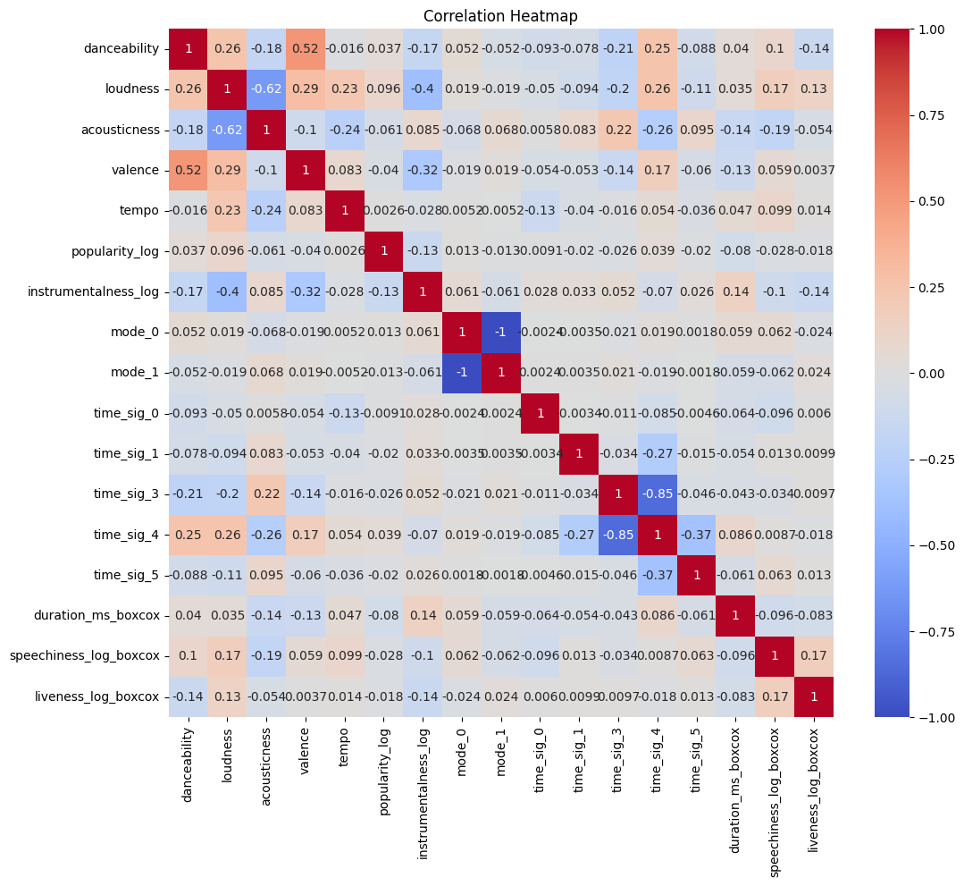
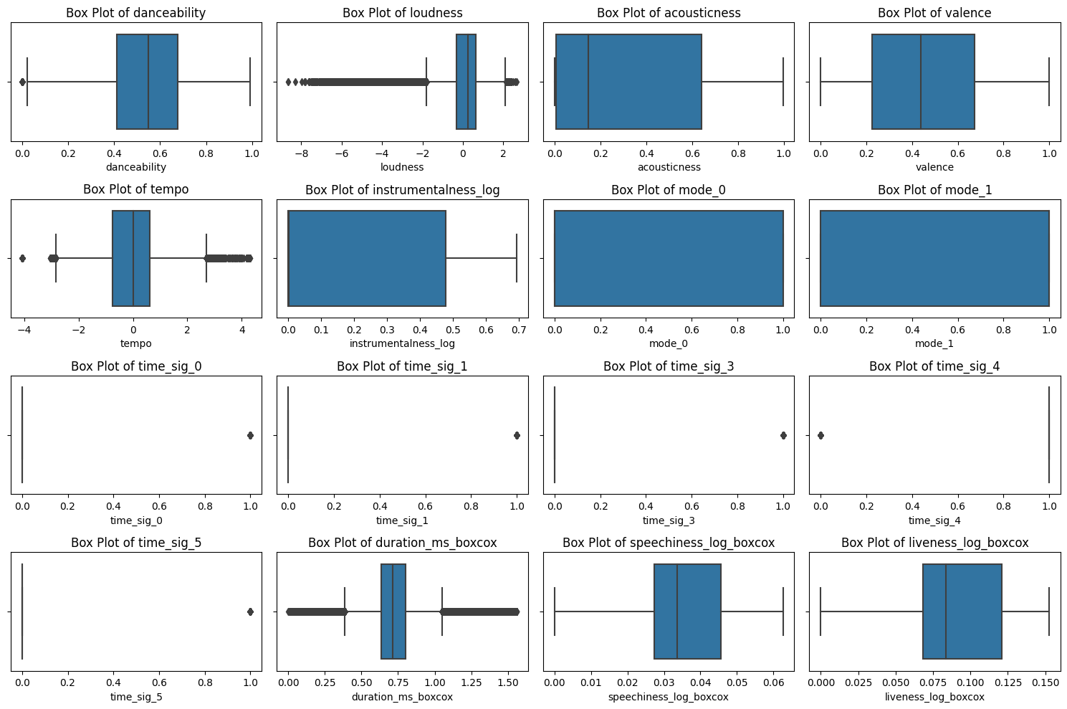
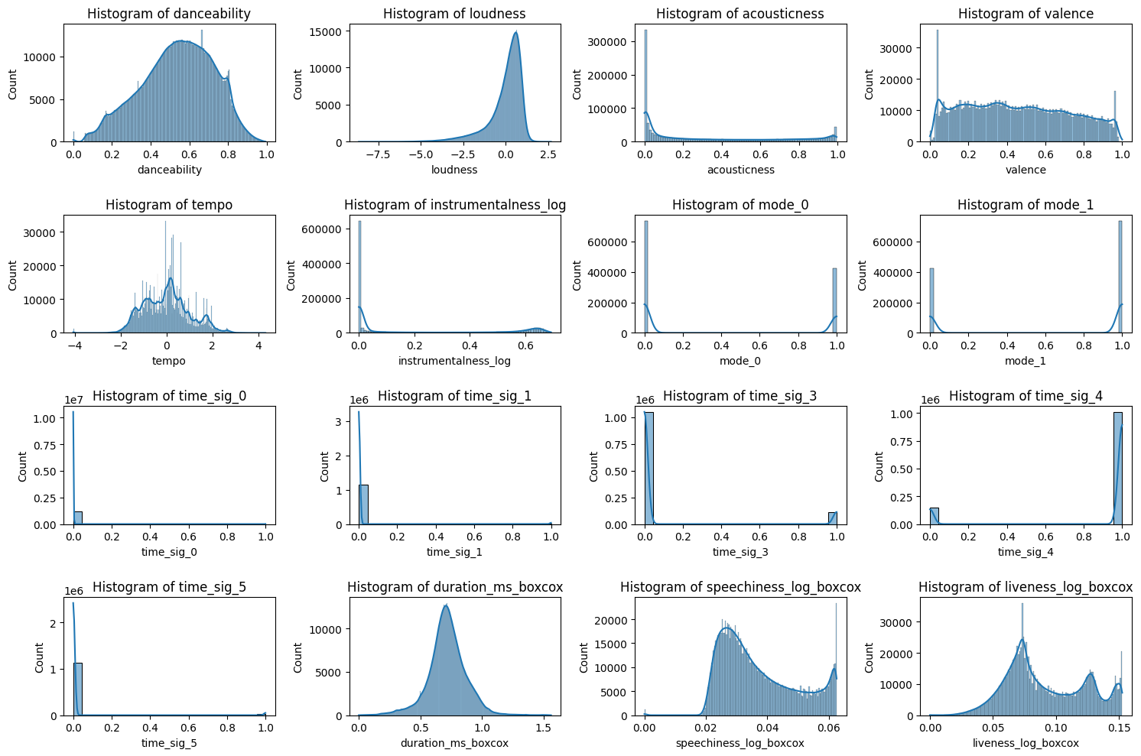
Insights from Graphs

Slide 14
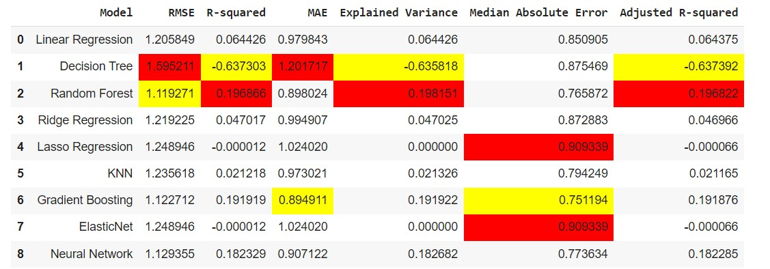
Results
Random Forest and Gradient Boosting have the highest R-squared values, suggesting better model fits compared to others.
Neural Network presents a good balance with a relatively high R-squared and lower RMSE, indicating it performs well on the data.

Slide 15

Conclusion
P-Values show audio feature significance
Error Metrics shows overall poor predictions
Adjusted R-Square shows poor variable explanation of change in popularity
Relatively, Random Forest and Gradient boosting models perform the best followed by the Neural Net model
The Audio features have some predictive power but they don’t capture the whole picture
Back to Research Questions:

Slide 16

Research Questions Addressed
What audio features most significantly predict a song's popularity on platforms like Spotify?
How can predictive models informed by stock market forecasting techniques be adapted for the music industry? Can it have high accuracy?
What is the correlation between Spotify's audio feature data and the commercial success of a song across different revenue streams?
How can music labels and artists use quantitative data to make informed decisions about which songs to promote?
To what extent can historical Spotify data be used to create an accurate popularity scoring system for new music tracks?
What challenges exist in creating a predictive algorithm for song popularity that is robust across various music genres and artist profiles?
How does the predictive model account for the dynamic and evolving trends in music consumption and audience preferences?

Slide 17

Final Thoughts and Real World Application
Potential in specific models
Platform for greater computing speed
Hyperparameter tuning
Aim for greater Adjusted R-square and negligible errors
How the final product would be used by Music labels and Artistes
A likely Scenario

Slide 18

Thank you For Listening

Slide 19

References
Araujo, C. S., Cristo, M., & Giusti, R. (2019). Predicting Music Popularity on Streaming Platforms. Anais Do Simpósio Brasileiro de Computação Musical (SBCM 2019). https://doi.org/10.5753/sbcm.2019.10436
Yutong, G., Yutong, S., & Jiaqian, W. (2021, May 26). Popularity Prediction of Music Based on Factor Extraction and Model Blending. Ieeexplore.ieee.org. https://ieeexplore.ieee.org/stamp/stamp.jsp?tp=&arnumber=9434816
Beniwal, R., Gupta, S., Shekhar, S., & Batra, S. (2023, August 7). Hindi Hit Songs Prediction Using Machine Learning Algorithms. Ieeexplore.ieee.org. https://ieeexplore.ieee.org/stamp/stamp.jsp?tp=&arnumber=10205626
Kamal, J., Priya, P., Anala, M. R., & Smitha, G. R. (2021). A Classification Based Approach to the Prediction of Song Popularity. 2021 International Conference on Innovative Computing, Intelligent Communication and Smart Electrical Systems (ICSES), Innovative Computing, Intelligent Communication and Smart Electrical Systems (ICSES), 2021 International Conference On, 1–5. https://doi.org/10.1109/ICSES52305.2021.9633884
Martin-Guiterrez, D., Hernández-Peñaloza, G., Belmonte-Hernandez, A., & Álvarez García, F. (2020, February 24). A Multimodal End-to-End Deep Learning Architecture for Music Popularity Prediction. Ieeexplore.ieee.org. https://ieeexplore.ieee.org/abstract/document/9007339/citations#citations
Pham, J., & Kyauk, E. (2015). Predicting Song Popularity. https://cs229.stanford.edu/proj2015/140_report.pdf
Essa, Y., Usman, A., Garg, T., & Singh, K. (2022). Predicting the Song Popularity Using Machine Learning Algorithm. https://ijsret.com/wp-content/uploads/2022/05/IJSRET_V8_issue2_281.pdf

